Slide 1
Next Up:
Attention: There is a fire alarm scheduled at 1 pm (right when this presentation should start). This is only a fire alarm test. Do not leave, stay here – everything is going to be fine :-)
Miriam C. Wiesner

Slide 2
3
3

Slide 3
2

Slide 4
1

Slide 5
Echoes of Intrusion Demystifying commonly used MS Graph API Attacks
Miriam C. Wiesner

Slide 6

Many thanks to our sponsors:

Slide 7



Miriam C. Wiesner
Sr. Security Research Program Manager @ (recently: Sr. Security Researcher)
Author of the book “PowerShell Automation and Scripting for Cybersecurity - Hacking and defense for red and blue teamers”
MS Graph noob, just using it for research, fun and profit ;-)

Slide 8
Other great sessions, to elevate your MS Graph learning
Tuesday, 25th June – 09:00
Christian Ritter – Create a custom Microsoft Graph connector with PowerShell
Tuesday, 25th June – 14:00
Ben Reader – No Passwords, No Problem: Secure Azure Authentication with MSAL & PowerShell
Wednesday, 26th June – 10:00
Emanuel Palm – From Cloudy to Clear: Demystifying Azure Authentication

Slide 9
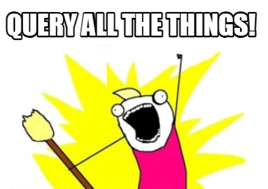
What is Microsoft Graph?
An interface to interoperate with Microsoft 365
Get started with Graph Explorer:
https://developer.microsoft.com/en-us/graph/graph-explorer

Slide 10

Graph API basics
https://github.com/Azure/Cloud-Katana
Get-CKDeviceCode
Get-CKAccessToken
Authentication
Access token
Access resources
Permissions – e.g. Mail.Read, …
API endpoint URL – e.g. https://graph.microsoft.com/v1.0/users/
Invoke-RestMethod
–Uri <Uri>
–Method <HttpMethod>
–Header <Header Parameters>
–Body <Body Parameters>

Slide 11
Graph API basics
$RequestUri = "https://graph.microsoft.com/v1.0/me/changePassword"
$HttpMethod = “POST”
$Header = @{
"Authorization" = "Bearer $AccessToken"
"Content-Type" = "application/json"
}
$BodyAsJson = @{
"currentPassword“ = “123456“
"newPassword" = “654321"
} | ConvertTo-Json -Depth 20
$Params = @{
Headers = $Header
Uri = $RequestUri
Body = $BodyAsJson
Method = $HttpMethod
}
Invoke-RestMethod @Params

Slide 12




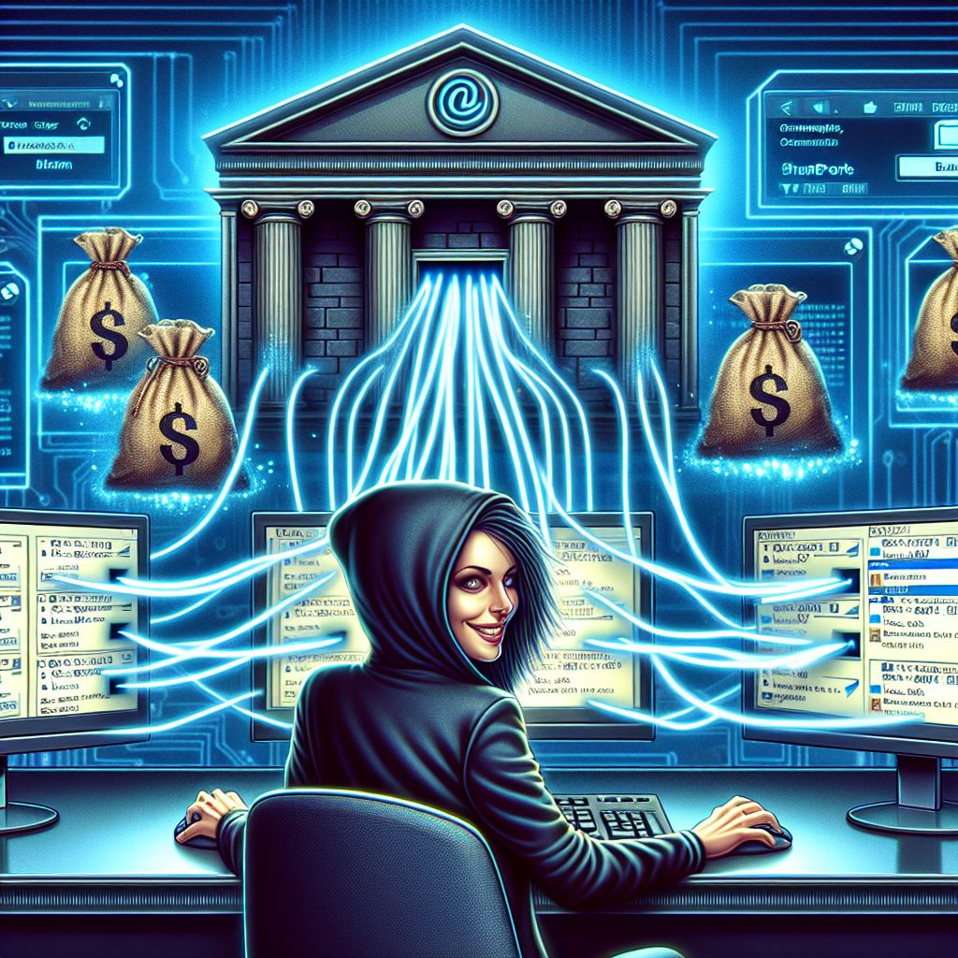
The attack path
Initial Access
Discovery
Privilege escalation
Persistence
Extracting information
*Disclaimer: This demo represents part of my research. All
example scripts were recreated by myself.

Slide 13








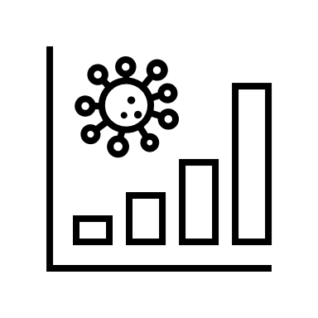



The attack path
Login as Service Principal
Login as Service Principal
Owner
Miriam-Victim@ DefenderATEVET06. onmicrosoft.com
Application MW-MailReadApp
Mail.Read
Application MW-Victim-SP
Application.ReadWrite.All
Adversary
Discovery

Slide 14
Demo

Slide 15

Initial Access

Slide 16
Discovery

Slide 17
Privilege escalation

Slide 18
Persistence

Slide 19
Extracting information

Slide 20
Detect & Defense
Educate your users on how to select good passwords
Monitor and investigate unusual logon attempts
From the same IP address
Many accounts at the same time
Enable MFA, conditional access, identity protection policies, and configure lockout policies
Block legacy authentication
Apply Secure Score recommendations

Slide 21
Detect & Defense
Protect your high value devices and servers (DCs, SAW)
Retain a high credential hygiene standard
Regularly audit your configuration
Review and restrict access to key vaults
Add processes and tools to automatically check your configuration and code for stored passwords
Review dangerous roles and permissions (user accounts AND service principals)

Slide 22


Some Dangerous Permissions*
General Dangerous Permissions
*.ReadWrite
*.FullControl
*.Write
*.Manage
AppRoleAssignment.ReadWrite.All
Grant additional privileges to itself or other applications
Grant Admin Consent
RoleManagement.ReadWrite.Directory
Grant additional privileges to itself or other applications
Directory.ReadWrite.All
Read and write to the directory, equals Global Administrator rights
User.ReadWrite.All
Read and write full user profile
Reset passwords
Group.ReadWrite.All
Read and write group properties
Set Group Membership
Application.ReadWrite.All
Add new credentials to any other SP
Sites.Read.All
Read Sharepoint documents in all site collections
Sites.ReadWrite.All
Write Sharepoint documents to all site collections
Sites.FullControl.All
Full control in all site collections
Mail.Read
Read all mail boxes
* … of course there are more, but some of the most dangerous permissions are the ones listed here

Slide 23
Some Dangerous Roles*
ApplicationAdministrator:"9b895d92-2cd3-44c7-9d02-a6ac2d5ea5c3"
ApplicationDeveloper: "cf1c38e5-3621-4004-a7cb-879624dced7c"
AuthenticationAdministrator: "c4e39bd9-1100-46d3-8c65-fb160da0071f"
AuthenticationExtensibilityAdministrator: "25a516ed-2fa0-40ea-a2d0-12923a21473a"
B2CIEFKeysetAdministrator: "aaf43236-0c0d-4d5f-883a-6955382ac081"
CloudApplicationAdministrator: "158c047a-c907-4556-b7ef-446551a6b5f7"
CloudDeviceAdministrator: "7698a772-787b-4ac8-901f-60d6b08affd2"
ConditionalAccessAdministrator: "b1be1c3e-b65d-4f19-8427-f6fa0d97feb9"
DirectorySynchronizationAccounts: "d29b2b05-8046-44ba-8758-1e26182fcf32"
DirectoryWriters: "9360feb5-f418-4baa-8175-e2a00bac4301"
DomainNameAdministrator: "8329153b-31d0-4727-b945-745eb3bc5f31"
ExternalIdentityProviderAdministrator: "be2f45a1-457d-42af-a067-6ec1fa63bc45"
GlobalAdministrator: "62e90394-69f5-4237-9190-012177145e10"
GlobalReader: "f2ef992c-3afb-46b9-b7cf-a126ee74c451"
GlobalSecureAccessAdministrator: "ac434307-12b9-4fa1-a708-88bf58caabc1"
GroupsAdministrator: "fdd7a751-b60b-444a-984c-02652fe8fa1c"
HelpdeskAdministrator: "729827e3-9c14-49f7-bb1b-9608f156bbb8"
HybridIdentityAdministrator: "8ac3fc64-6eca-42ea-9e69-59f4c7b60eb2"
IntuneAdministrator: "3a2c62db-5318-420d-8d74-23affee5d9d5"
PartnerTier1Support: "4ba39ca4-527c-499a-b93d-d9b492c50246"
PartnerTier2Support: "e00e864a-17c5-4a4b-9c06-f5b95a8d5bd8"
PasswordAdministrator: "966707d0-3269-4727-9be2-8c3a10f19b9d"
PrivilegedAuthenticationAdministrator: "7be44c8a-adaf-4e2a-84d6-ab2649e08a13"
PrivilegedRoleAdministrator: "e8611ab8-c189-46e8-94e1-60213ab1f814"
SecurityAdministrator: "194ae4cb-b126-40b2-bd5b-6091b380977d"
SecurityOperator: "5f2222b1-57c3-48ba-8ad5-d4759f1fde6f"
SecurityReader: "5d6b6bb7-de71-4623-b4af-96380a352509"
UserAdministrator: "fe930be7-5e62-47db-91af-98c3a49a38b1"
* … of course, there might be more ;-)

Slide 24
Detect & Defense
Audit your SP permissions regularly:
Get-MsGraphApplicationPermissions.ps1
Watch for (unapproved) added credentials
Rights Management: encrypt your data and emails
XDR: monitor alerts
Monitor MSGraphActivityLogs for suspicious activities

Slide 25
Helpful resources
“Pentesting Azure Applications: The Definitive Guide to Testing and Securing Deployments” by Matt Burrough
Not specifically about MS Graph, but the information definitely supports your Azure Application Security Knowledge
https://github.com/Azure/Cloud-Katana
https://learn.microsoft.com/en-us/graph/permissions-reference
https://aka.ms/AzureADSecOps
https://aka.ms/IRPlaybooks
https://techcommunity.microsoft.com/t5/microsoft-entra-blog/microsoft-graph-activity-logs-is-now-generally-available/ba-p/4094535
https://learn.microsoft.com/en-us/graph/microsoft-graph-activity-logs-overview
https://learn.microsoft.com/en-us/azure/active-directory/fundamentals/concept-fundamentals-mfa-get-started
https://learn.microsoft.com/en-us/azure/active-directory/fundamentals/identity-secure-score
https://learn.microsoft.com/en-us/azure/active-directory/fundamentals/concept-secure-remote-workers
https://learn.microsoft.com/en-us/azure/active-directory/fundamentals/five-steps-to-full-application-integration-withazure-ad
https://learn.microsoft.com/en-us/azure/active-directory/fundamentals/concept-fundamentals-security-defaults
https://learn.microsoft.com/en-us/azure/active-directory/conditional-access/block-legacy-authentication
https://learn.microsoft.com/en-us/microsoft-365/security/office-365-security/detect-and-remediate-illicit-consent-grants

Slide 26
Q&A
15 minutes

